Slide 1
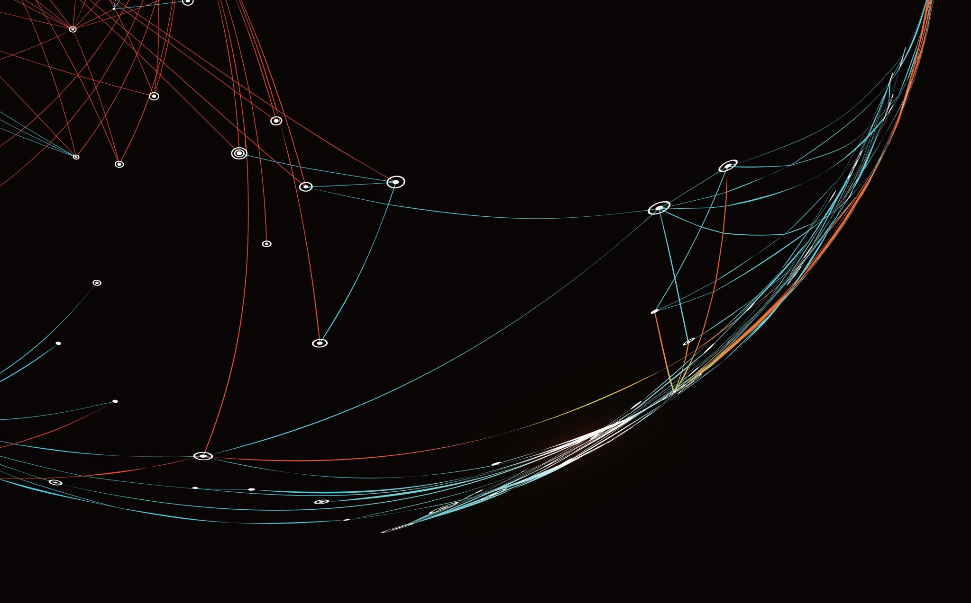
Benchmark – Milestone Assignment Final Presentation
By: Charles Osiris

Slide 2
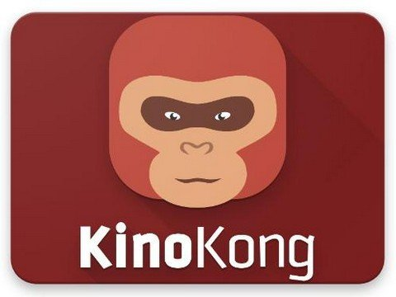
Introduction
Agenda:
Designing and implementing a “movie” web application where users can log in and gain access to watch available movies
Project Objectives:
Each user has login credentials as their email, password they created, and role assigned to them
Each movie holds its movie name, date released, list of primary actors, movie genre, country of origin, user rating, and YouTube link

Slide 3
Technology Overview and Implementation Approach
Our general technical approach to this project was essentially setting up a “movie” web application which features a login, registration, view movies, about us, and contact us/support pages.
From logging in, the user will be granted the ability to view various movies and rate them according to likeability.
From the home page, users are able to look for movies or tv shows, view the company’s core values, and contact support.
The application exhibits an admin page which allows for editing, adding, and removing movies, as well as users, from the list.
All the class data is stored securely on the MySQL database.

Slide 4
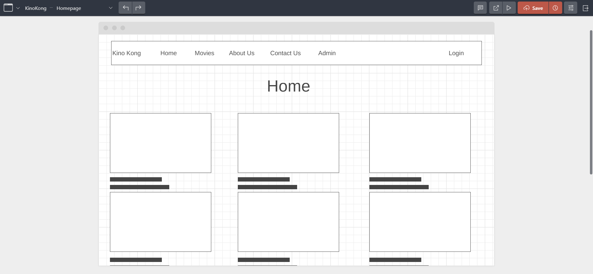
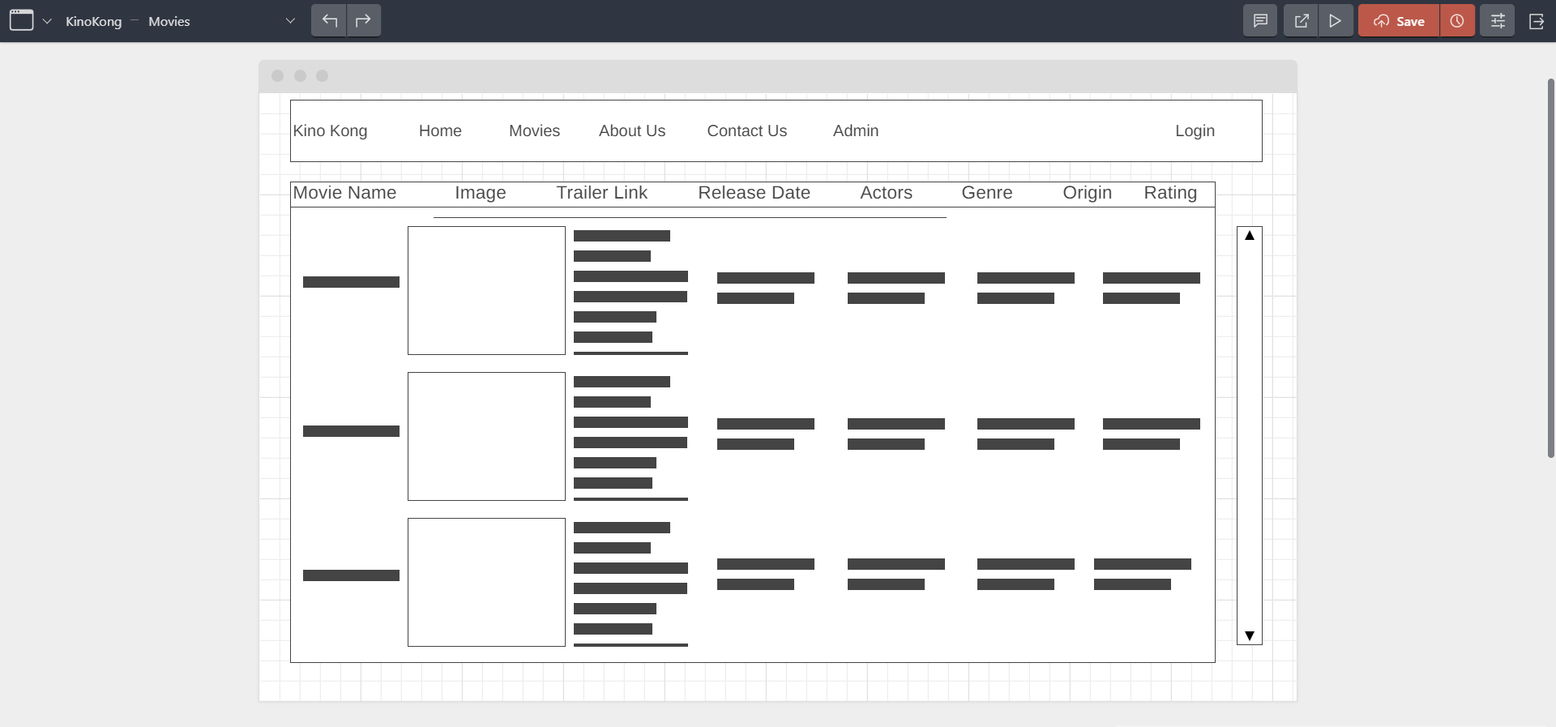
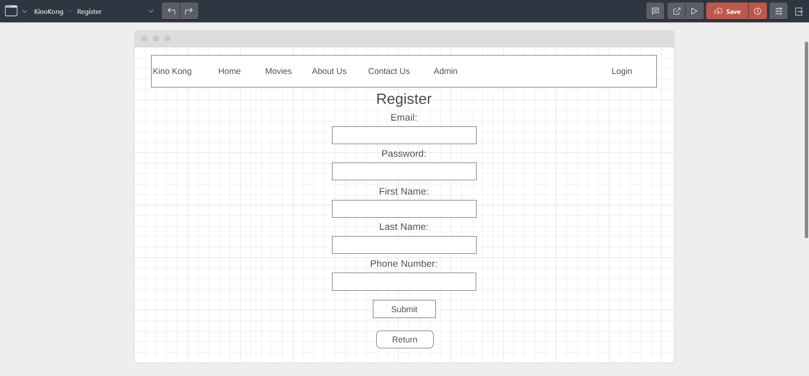
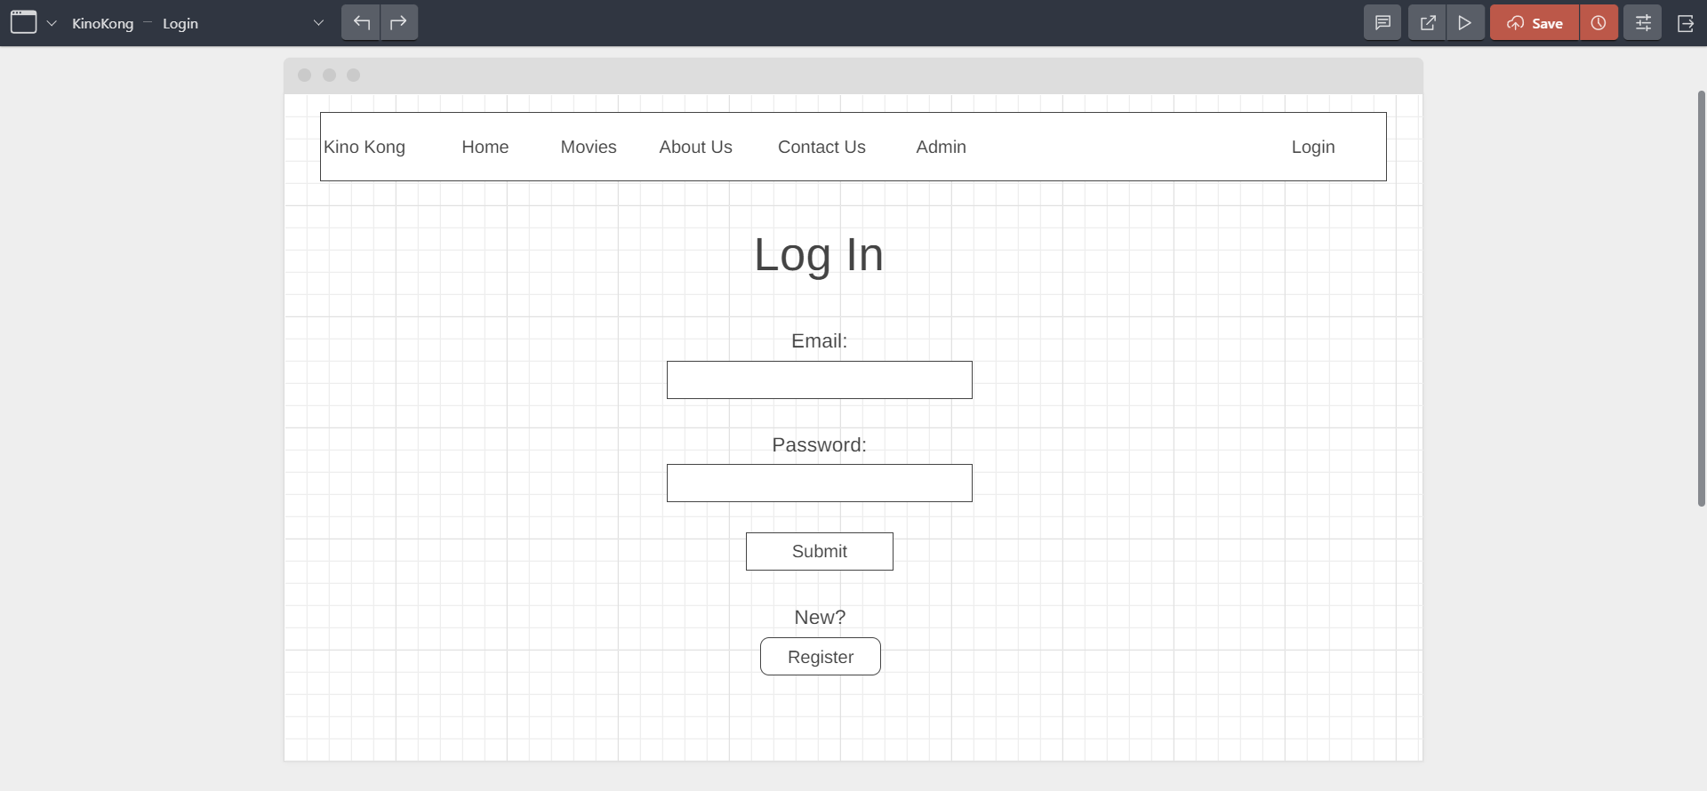

UI Design

Slide 5
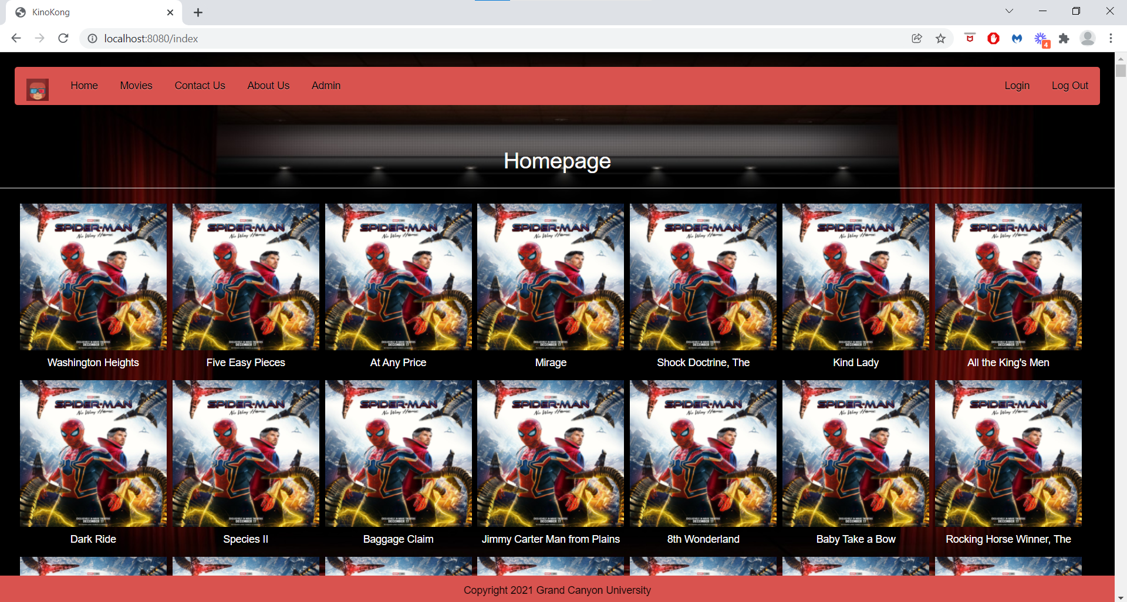

Slide 6
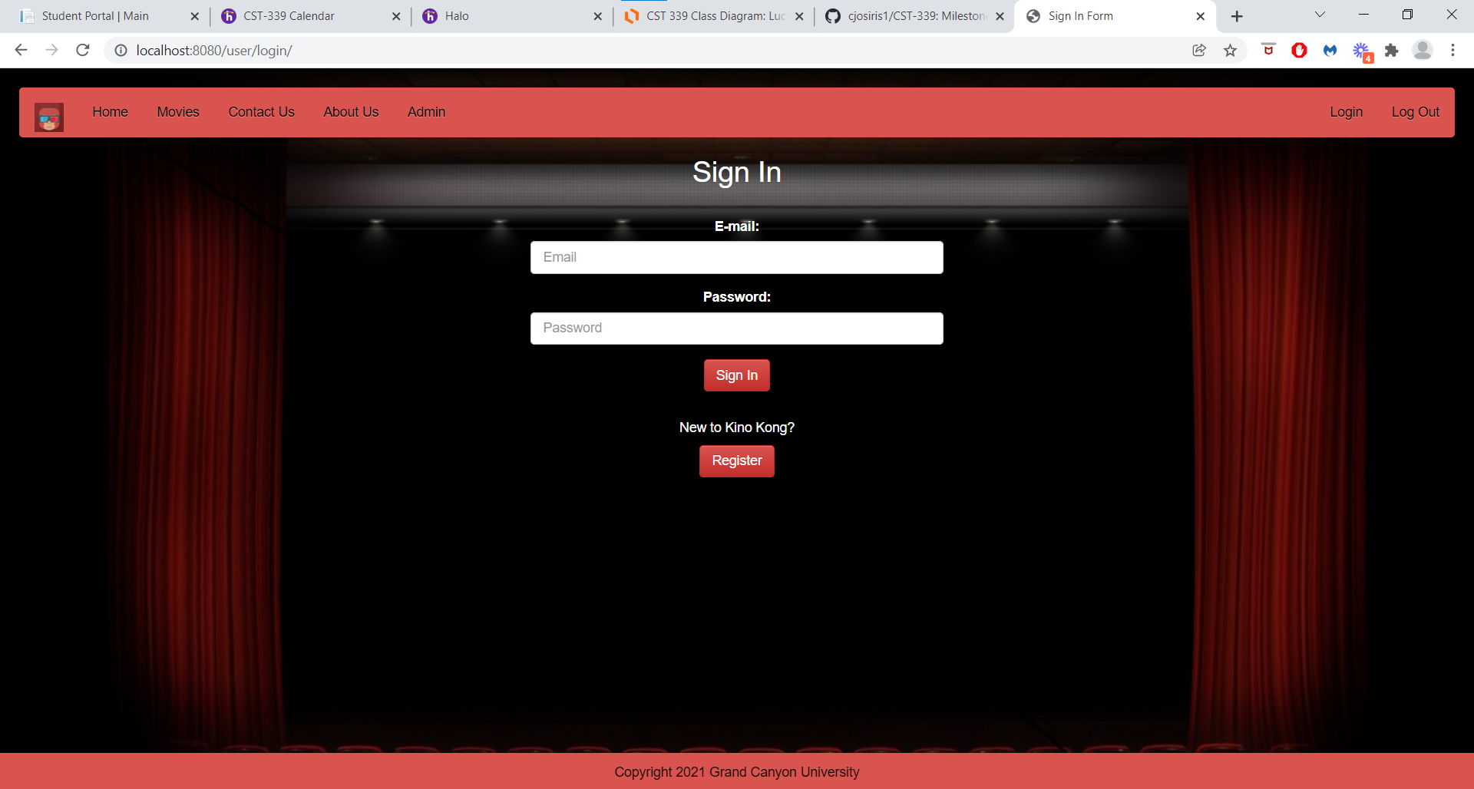

Slide 7
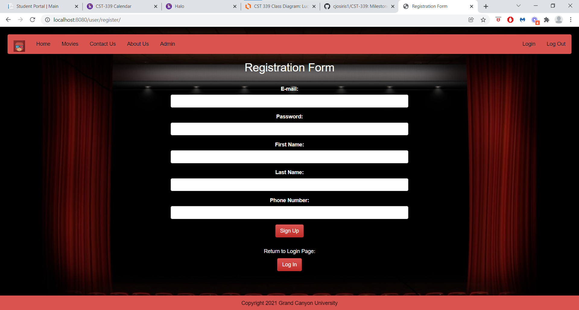

Slide 8

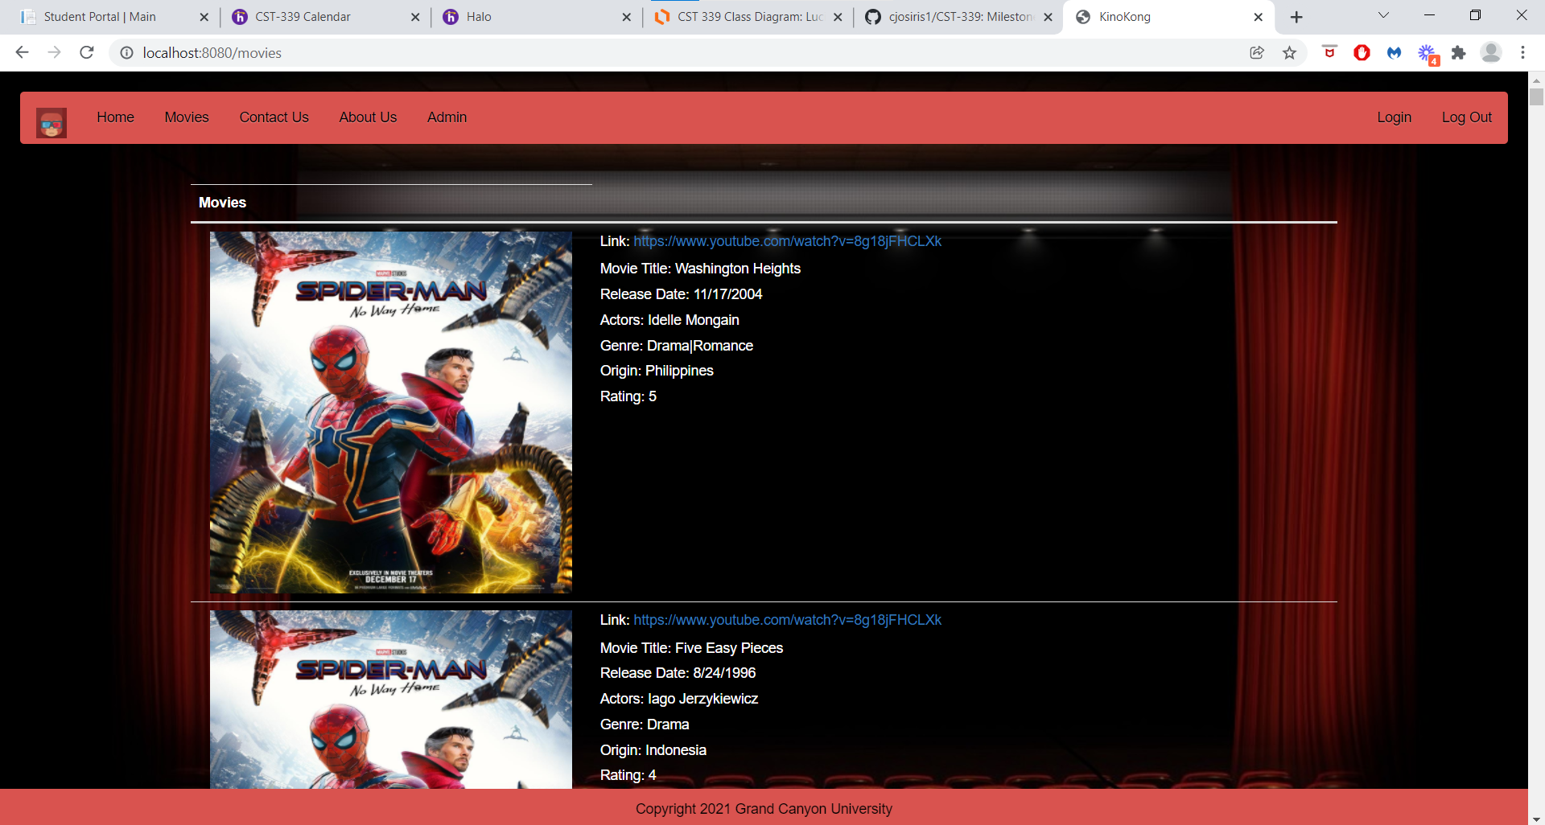
(Normal User) Movies Page

Slide 9
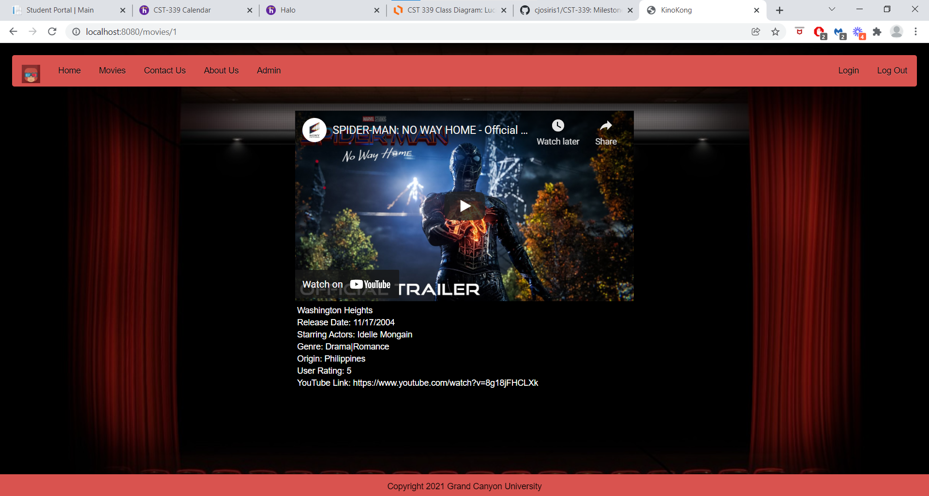

Slide 10
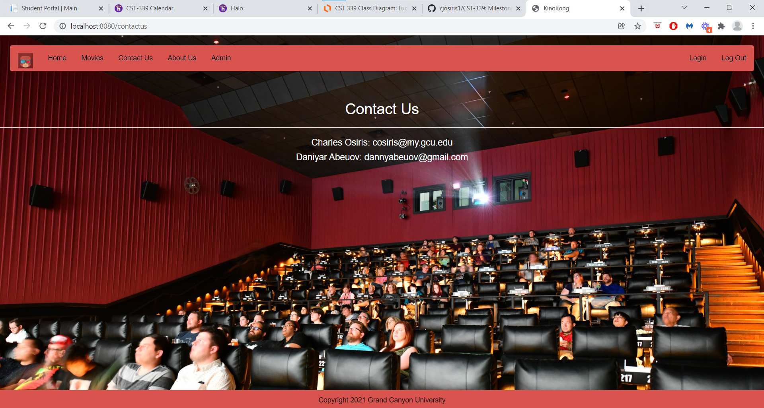

Slide 11
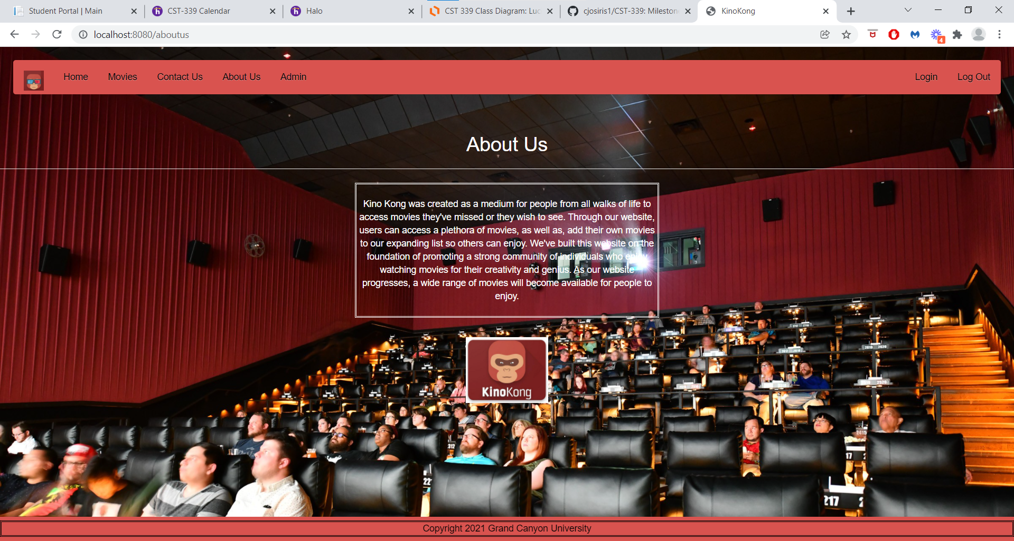

Slide 12
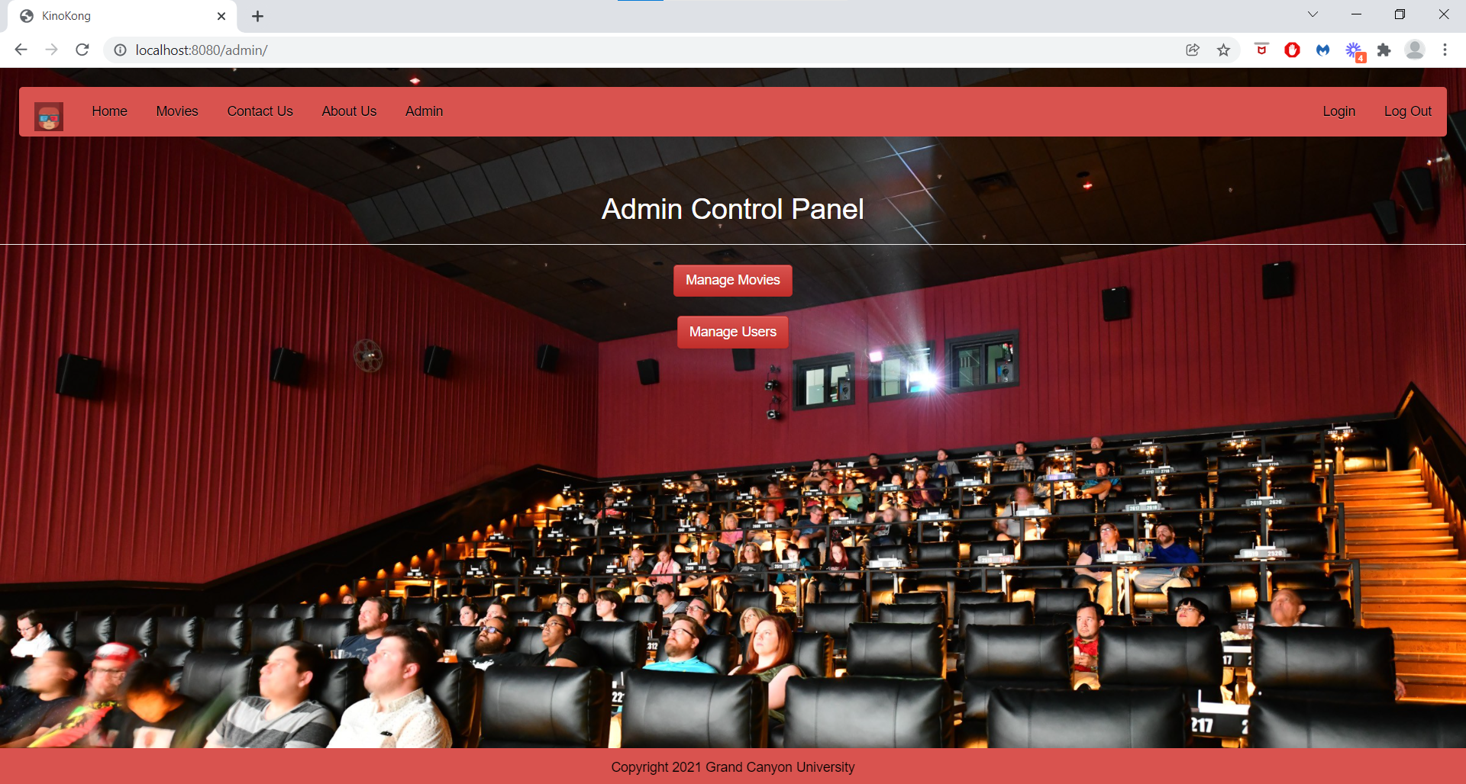
Admin Access Page

Slide 13
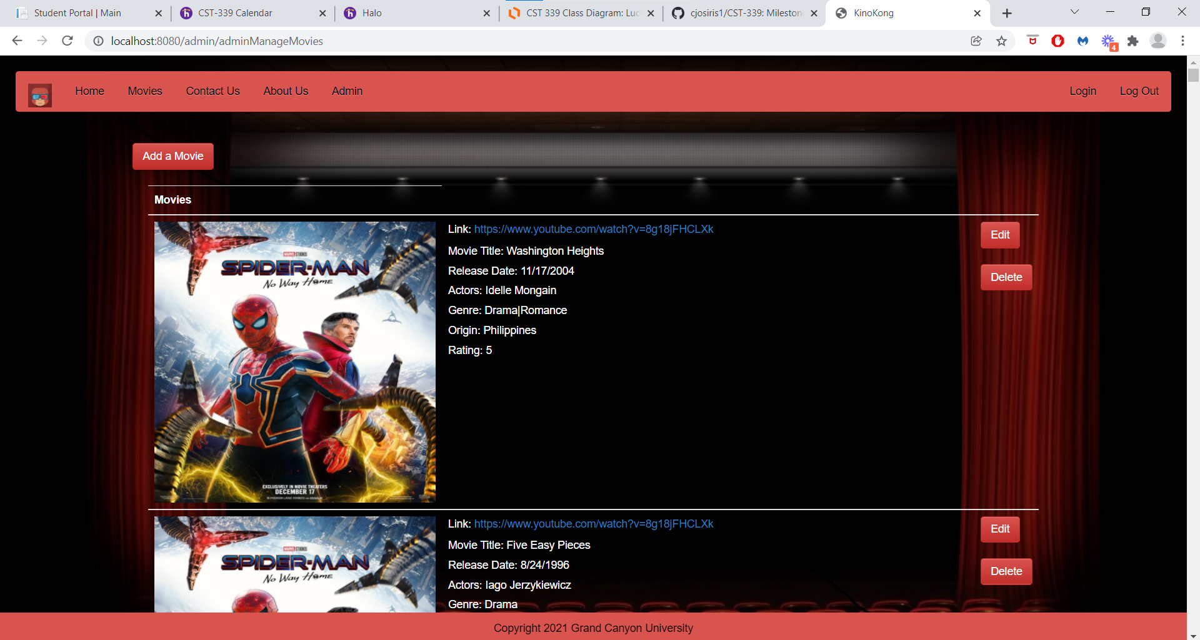
(Admin) Movies Page

Slide 14
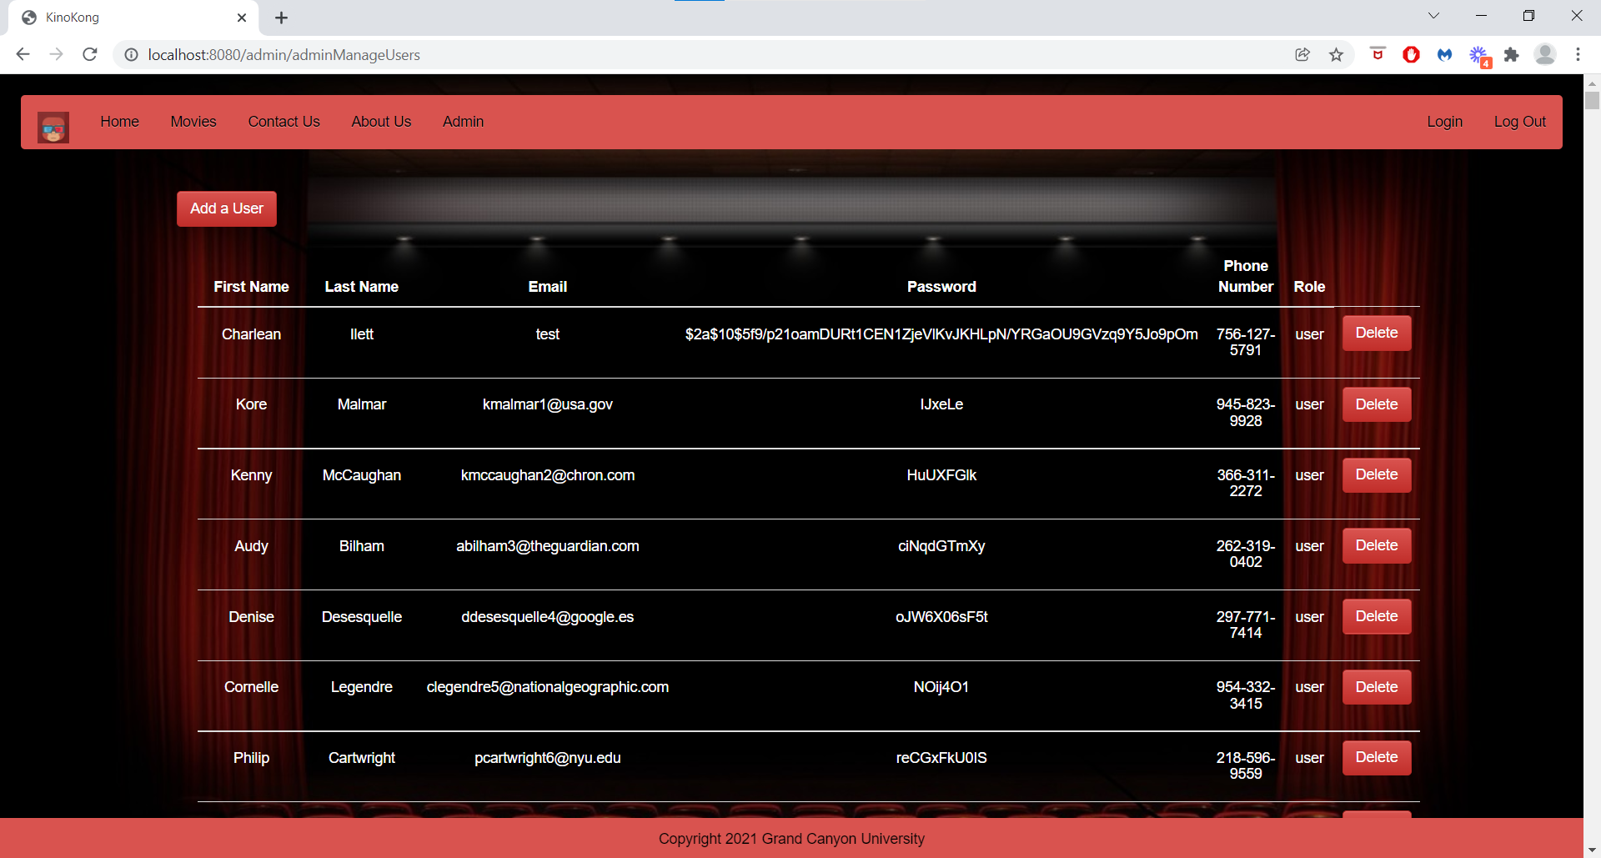
(Admin) Users Page

Slide 15
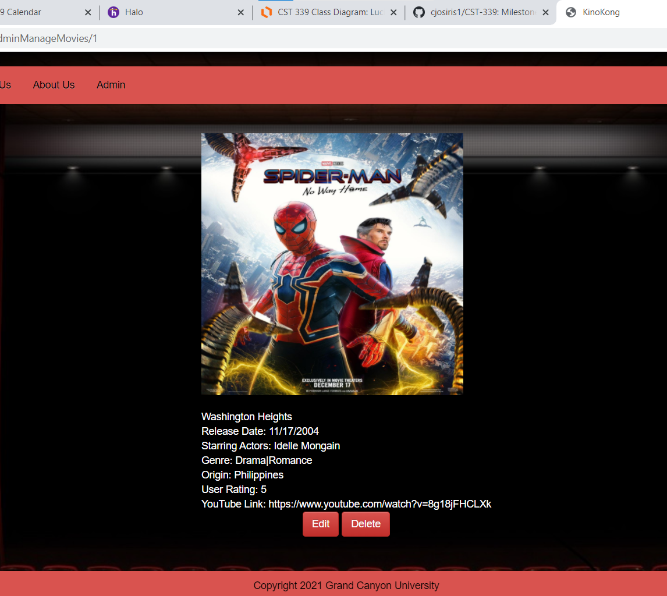
Edit Movies Page
Admins contain sudo commands over editing movie information for the website
Movies can be permanently deleted from the list

Slide 16
Technical Design Decisions
The Spring framework, Spring boot, and Maven were used for this web application.
The Spring Framework was used because of its ability to be employed on all architectural layers in development.
We were freely link modules, easily test them, and eliminate the need to independently create factory and singular classes.
Spring boot and Maven were used to speed up the dependency management process as it packages required third party dependencies within its starter packages, and because of its automatic configuration.

Slide 17
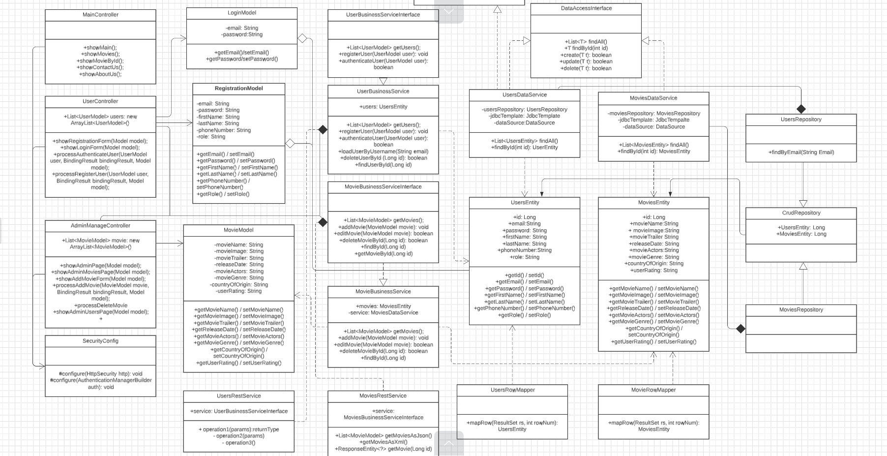
UML Diagram

Slide 18
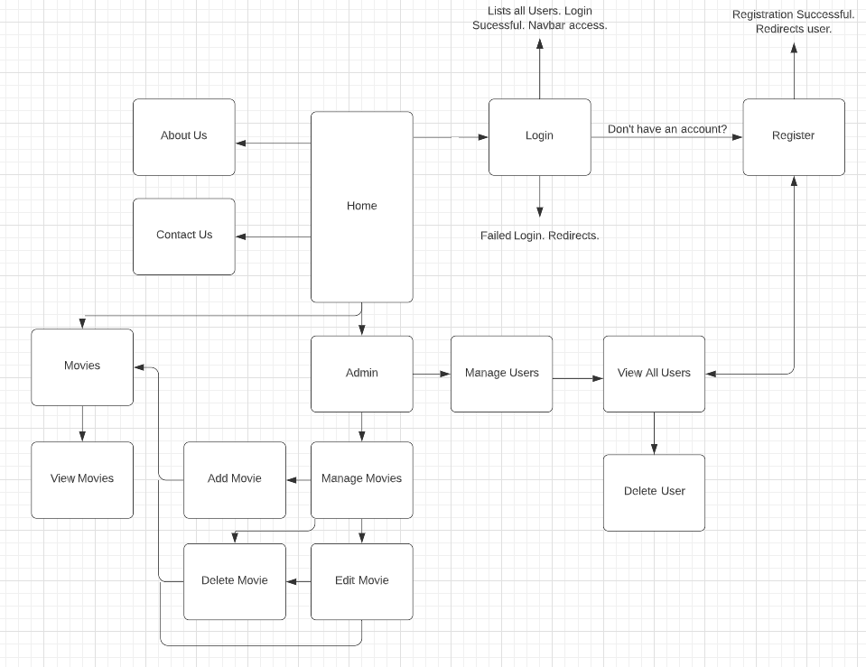
User Interface Diagram

Slide 19
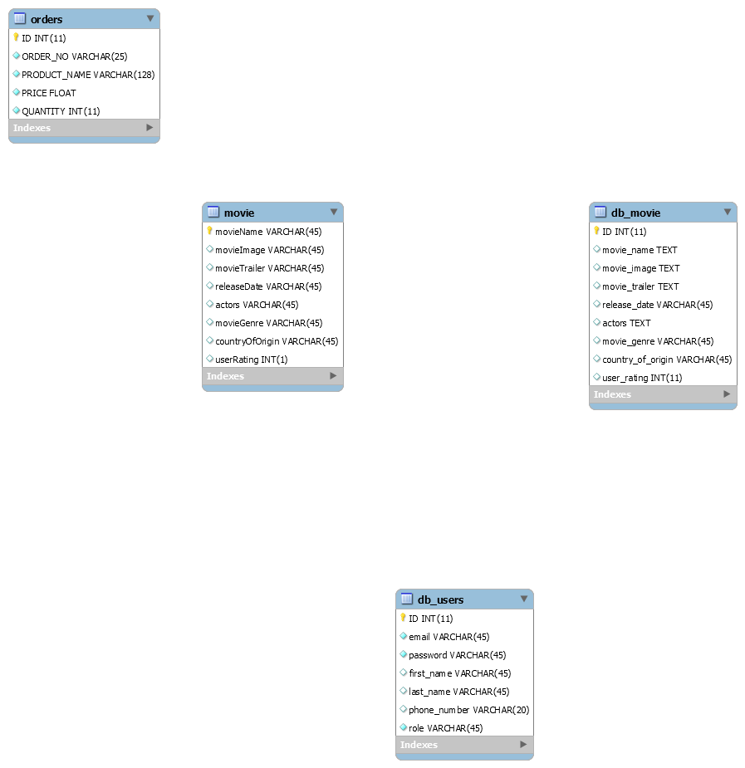
ER Diagram

Slide 20
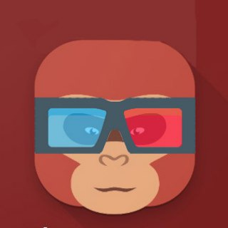
Teamwork
Our team held primary communication through text and GitHub
Each person in the group was designated the task of implementing and designing one feature each according to their knowledge and preference
Our team occasionally participated in coding sessions through Discord and the Tech building
I believe our mode of communication worked, and our projects were completed by their respective due dates.

Slide 21
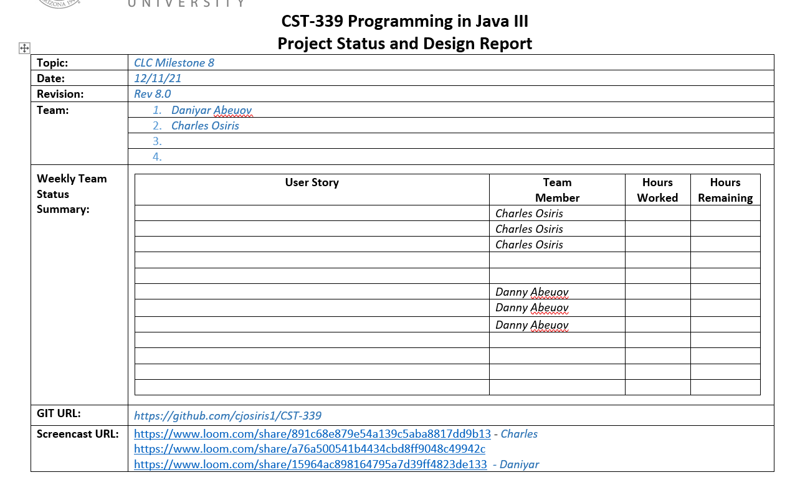
Specific Example of Planning Tools
User stories were created and uploaded to GitHub as we decided who would work on which areas
We kept in communication, when necessary, through text on deliverables
During sprints like when we added admin functionality and a separate movie listing for admin users
Work was separated into add, delete, and edit functionality, and creating separate web documents which would handle the tasks

Slide 22
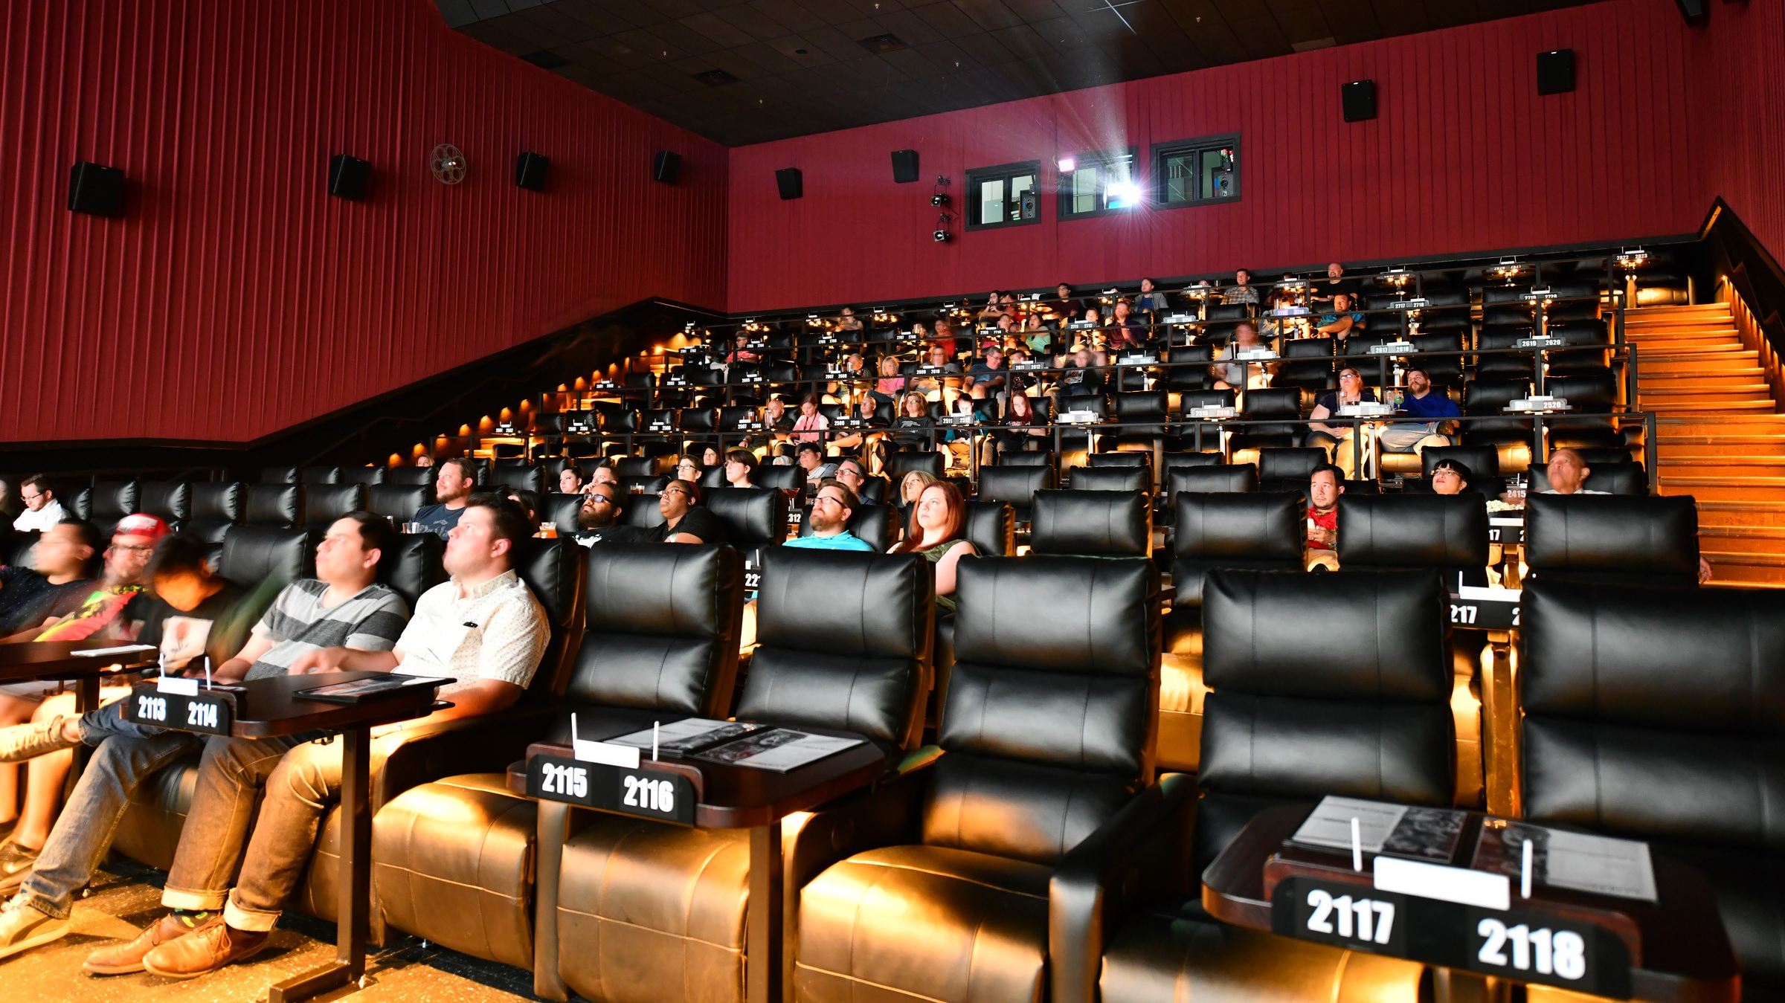
Demonstration

Slide 23
Limitations and Bugs
Early in the project, we encountered a problem with validation where the model passed could not contain the same name within different mappings
As we determined our website would be free of charge, we abandoned the use of the orders class within our ER Diagram
Individually grabbing each movies’ picture and YouTube link.
Fully Functional

Slide 24
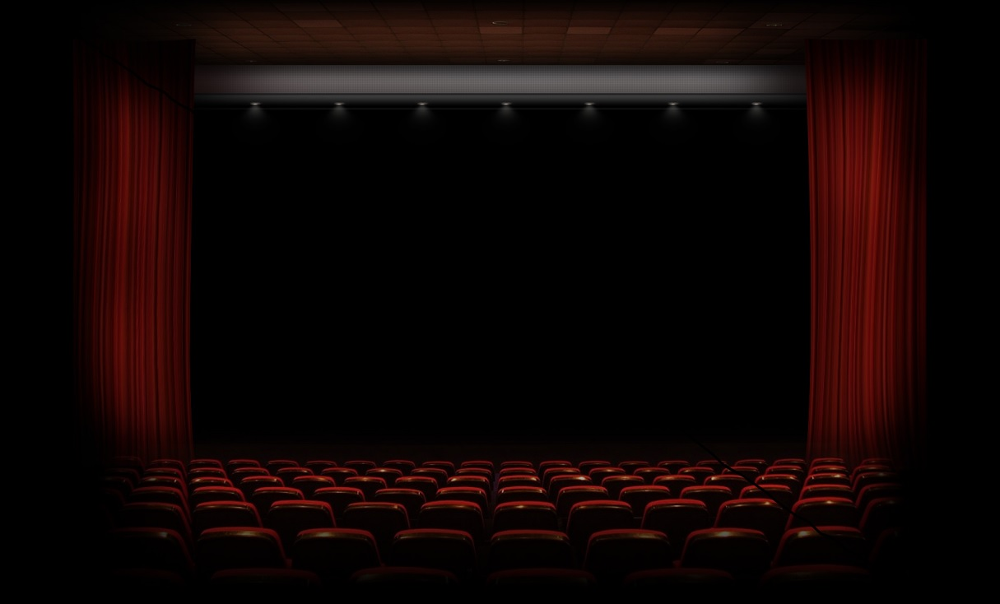
Closing
I believe this project, and this class, have been extremely helpful to my knowledge of coding. Many other classes do not necessarily have as many comparable applications to the corresponding parts of the industry I wish to pursue. I believe website functionality will remain relevant for the foreseeable future, and I believe my knowledge of website functionality and its setup have greatly increased during this semester. I’m properly able to secure and manage websites more to my knowledge. When I view webpages on the internet, I see the applications more in layers now, and am more interested in understanding how developers worked to achieve the presentation. Also, I’ve learned a variety of practices which I know will be used from an industry standpoint. I enjoyed this framework, thank you.

